Slide 1

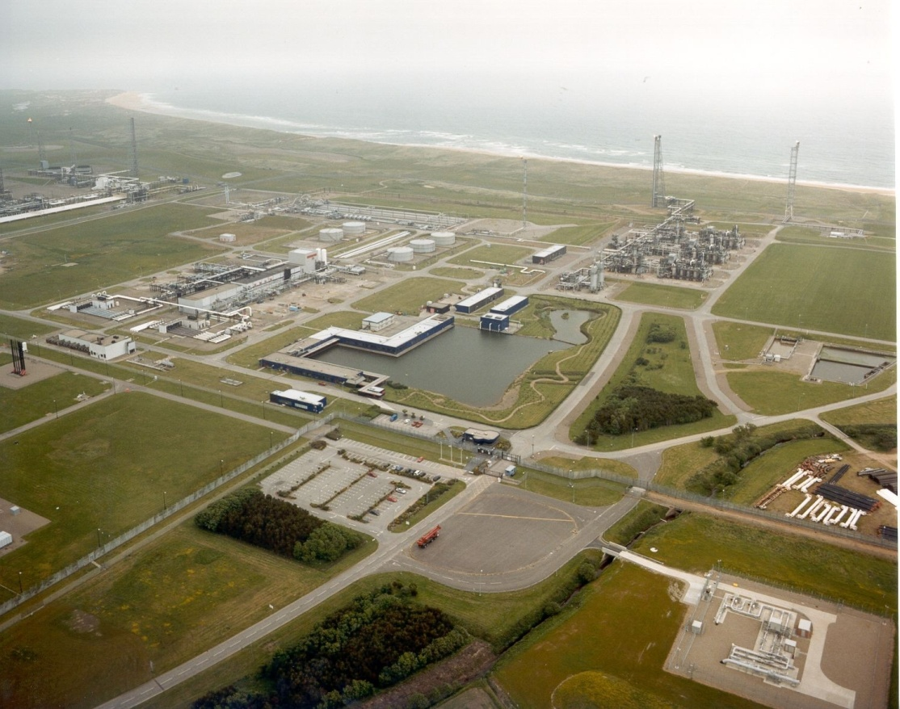


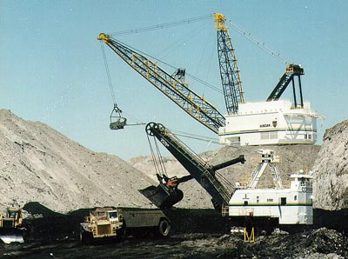
Overview of the Energy Industries

Slide 2



Overview of the Energy Industries
We use energy to provide:
Electricity
Heat
Light
Transport
From:
Fossil fuels
Oil
Gas
Coal
Nuclear
Large-scale hydroelectricity

Slide 3

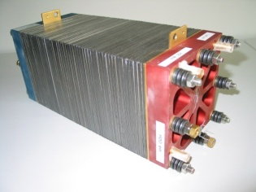
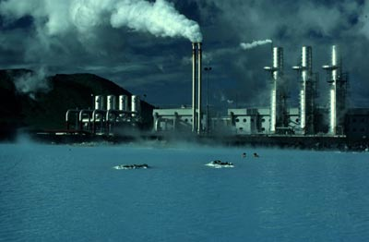
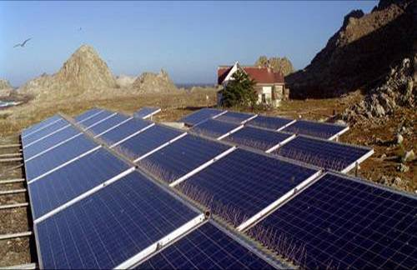
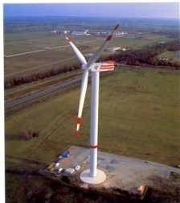

Overview of the Energy Industries
Rising energy demand
Need to stabilise atmospheric CO₂ at 550ppm
Aging fleet of coal & nuclear plant
Concerns about storage of nuclear waste
Declining oil & gas reserves 30- 50 years
Only 70 years of uranium left
Reduce reliance on hydrocarbons
Policy drivers:
Low Carbon Society
Security of Supply
Fuel Poverty
Gives greater emphasis on renewable sources of energy

Slide 4
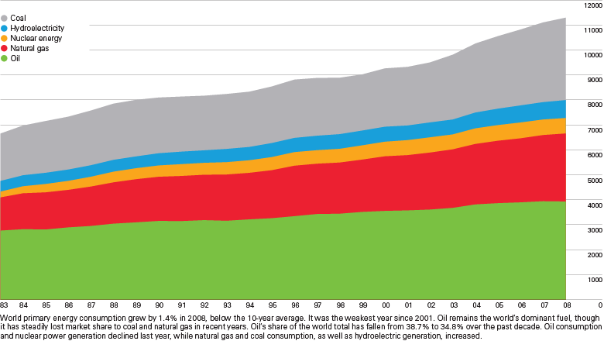
World primary energy consumption patterns 2008
World Consumption
Million tonnes oil equivalent
Source: BP Statistical Review of World Energy June 2009

Slide 5
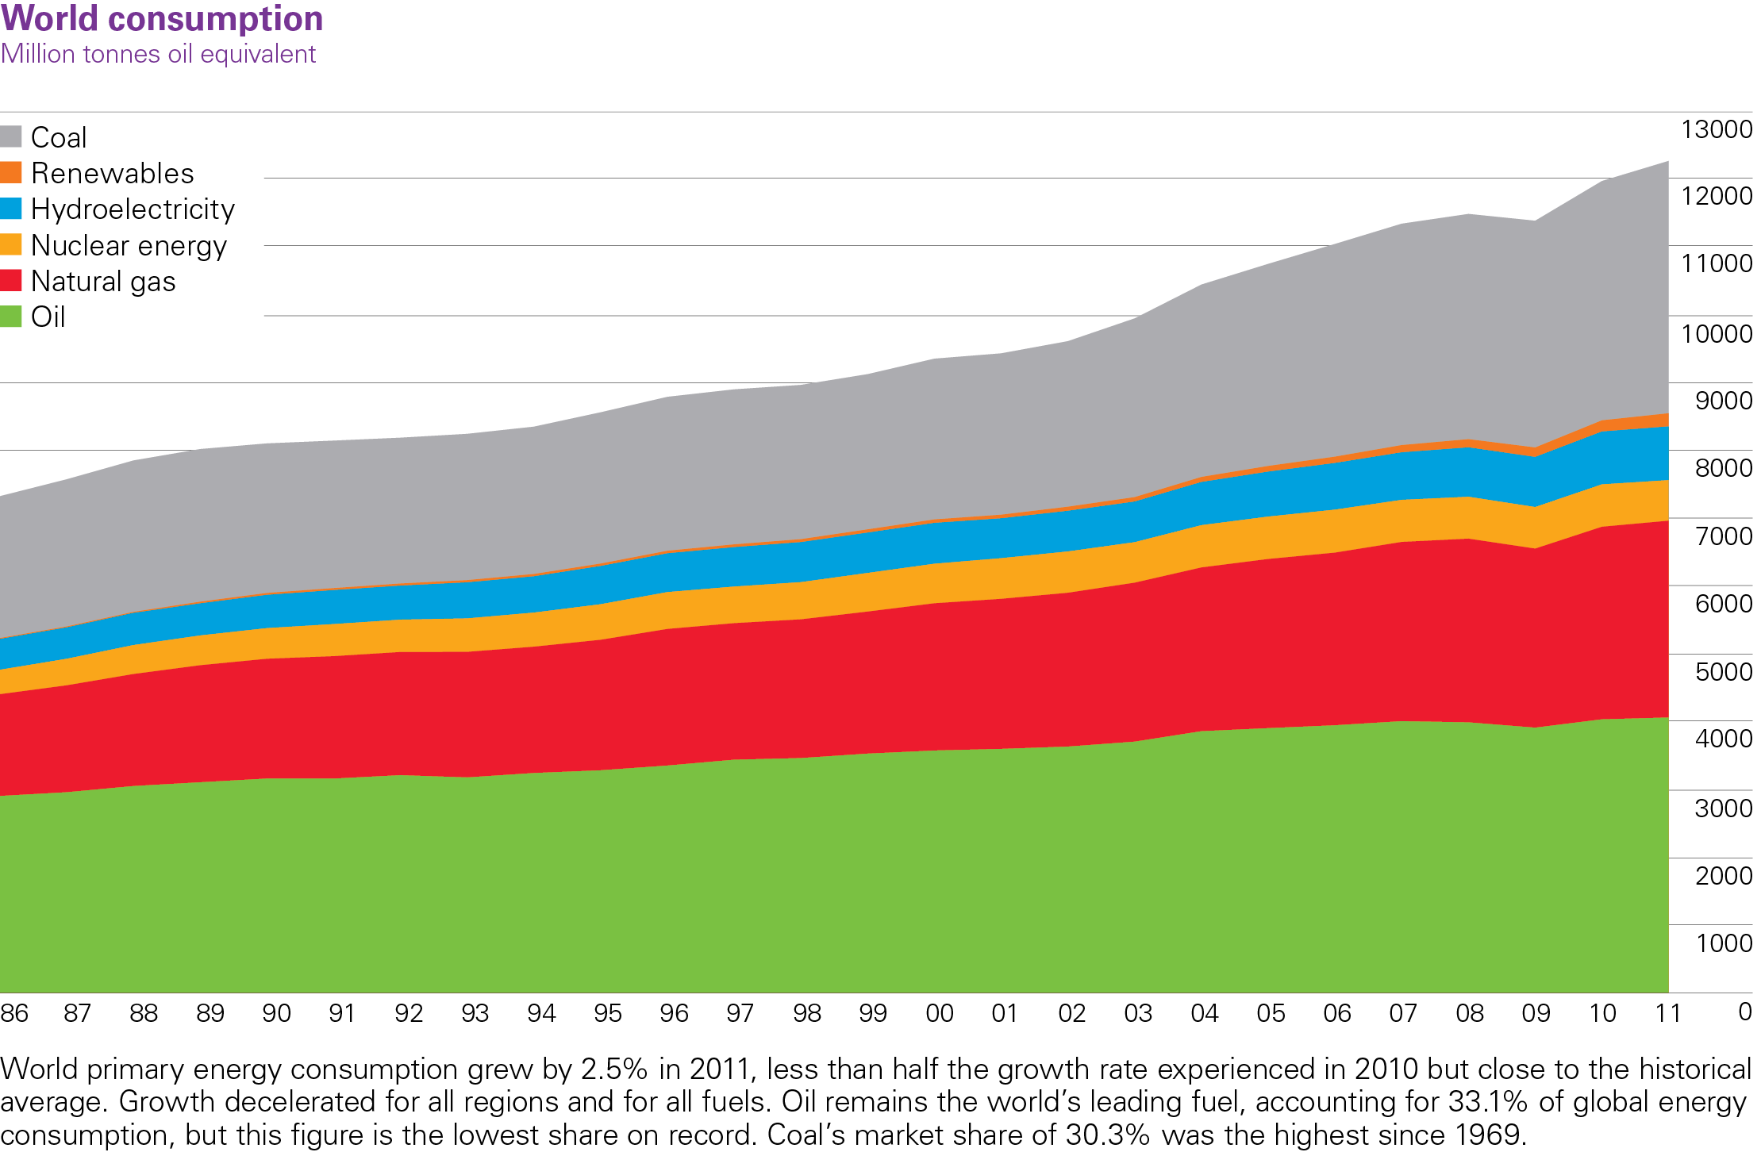
World primary energy consumption patterns 2011
BP Statistical Review of World Energy 2012
© BP 2012

Slide 6
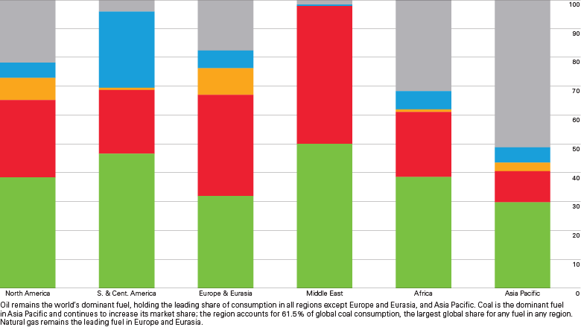
Regional primary energy consumption patterns 2008
Coal
Hydro
Nuclear
Percentage
Gas
Oil
Source: BP Statistical Review of World Energy June 2009

Slide 7
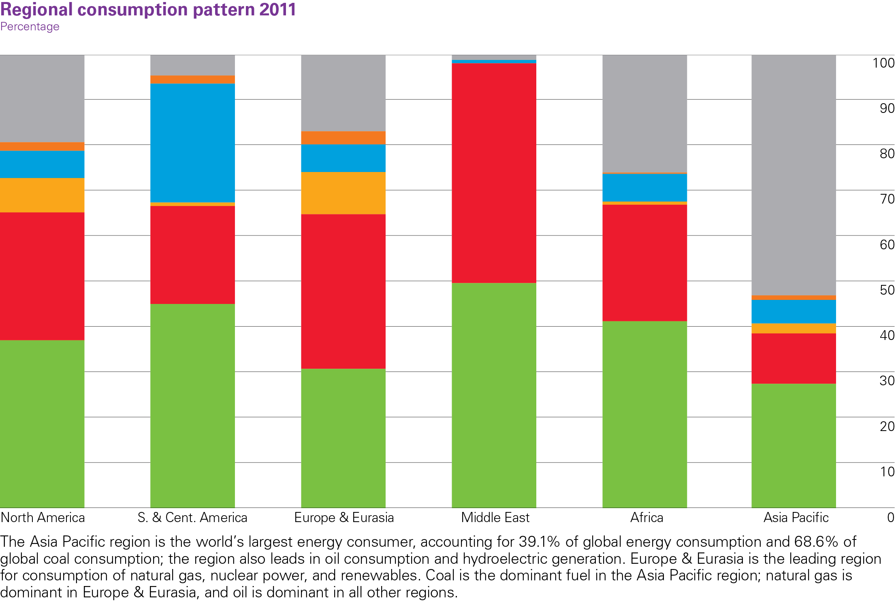
Primary energy consumption by region 2011
Coal
RET
Hydro
Nuclear
Gas
Oil
BP Statistical Review of World Energy 2012
© BP 2012

Slide 8
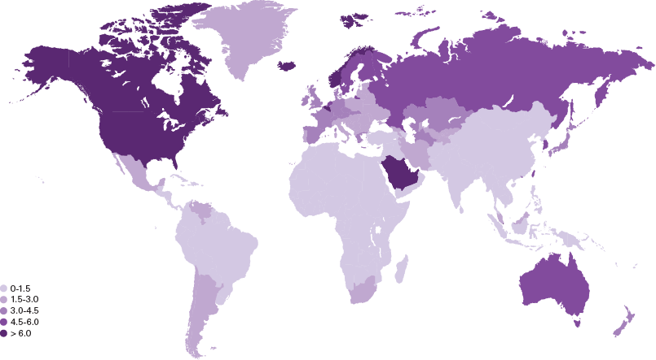
Primary energy consumption per capita
2008
Tonnes oil equivalent
Source: BP Statistical Review of World Energy June 2009

Slide 9
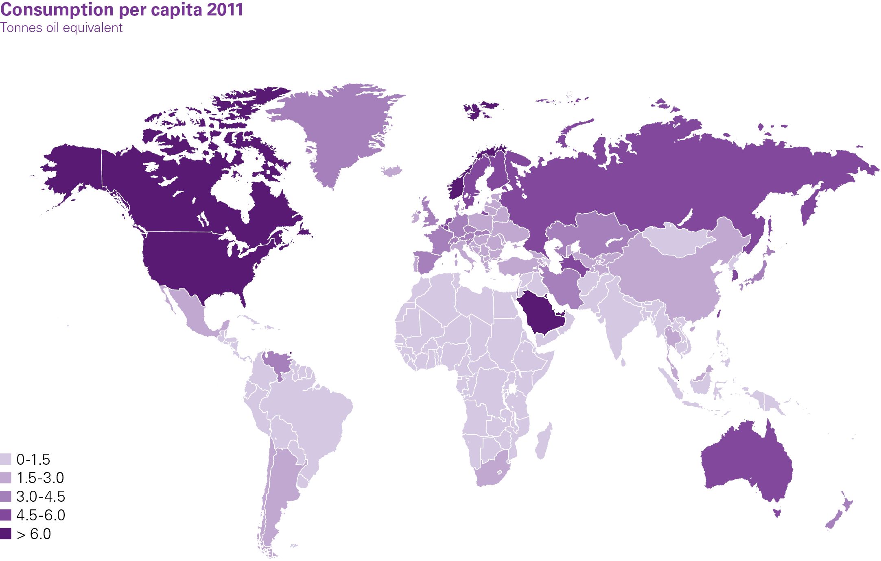
Primary energy consumption per capita
2011
BP Statistical Review of World Energy 2012
© BP 2012

Slide 10
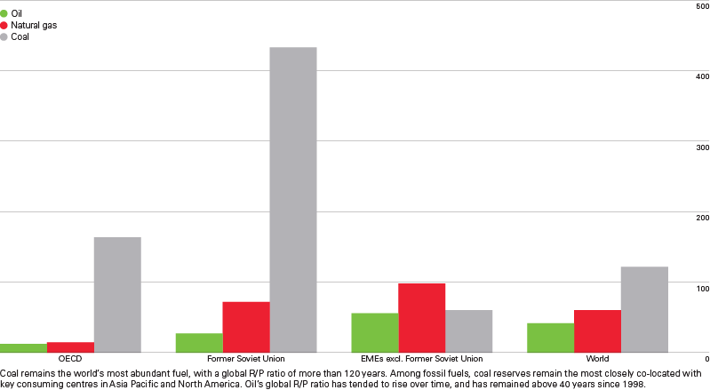
Fossil fuel reserves-to-production (R/P) ratios at end 2008
Years
Source: BP Statistical Review of World Energy June 2009

Slide 11
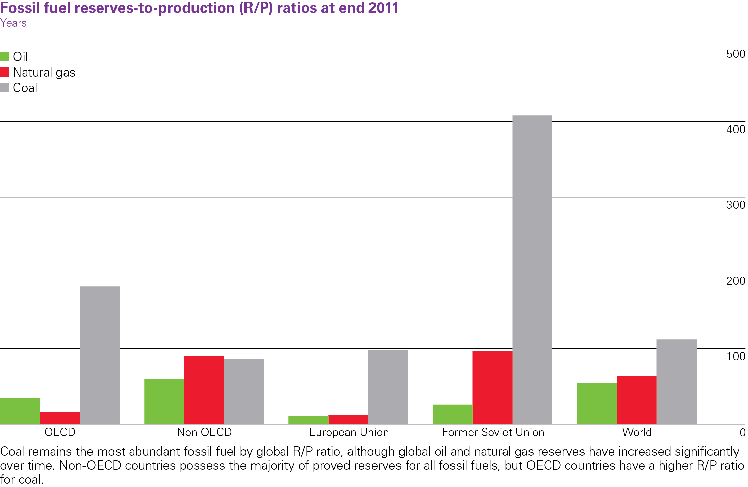
Fossil fuel reserves-to-production (R/P) ratios at end 2011
BP Statistical Review of World Energy 2012
© BP 2012

Slide 12
Oil

Slide 13
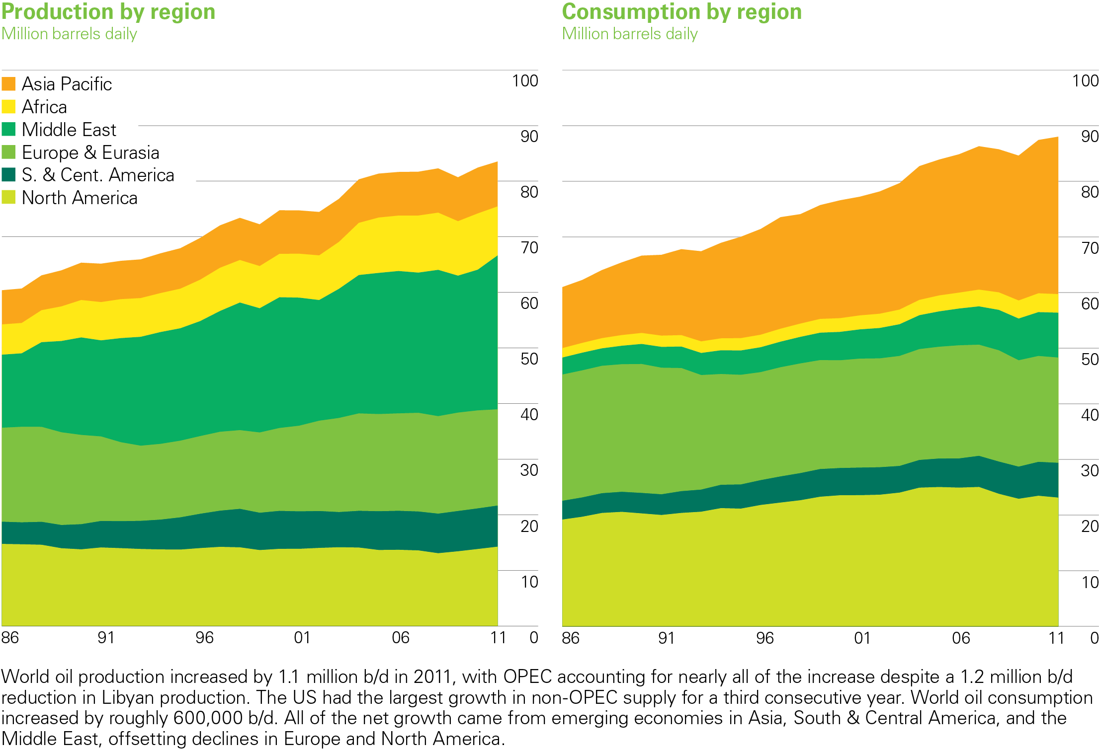
Oil production/consumption by region
2011
BP Statistical Review of World Energy 2012
© BP 2012

Slide 14
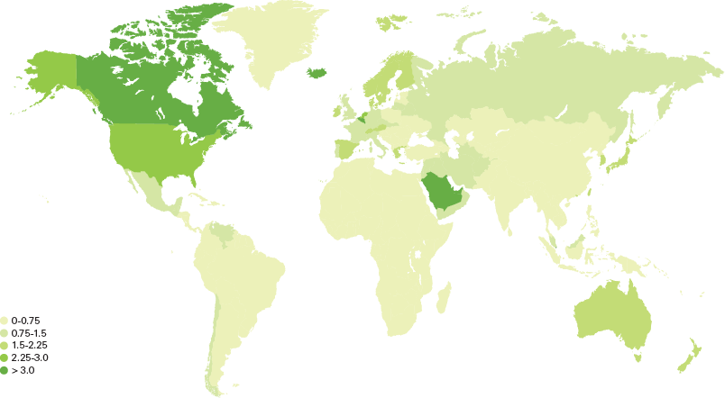
Oil consumption per capita 2008
Tonnes
Source: BP Statistical Review of World Energy June 2009

Slide 15
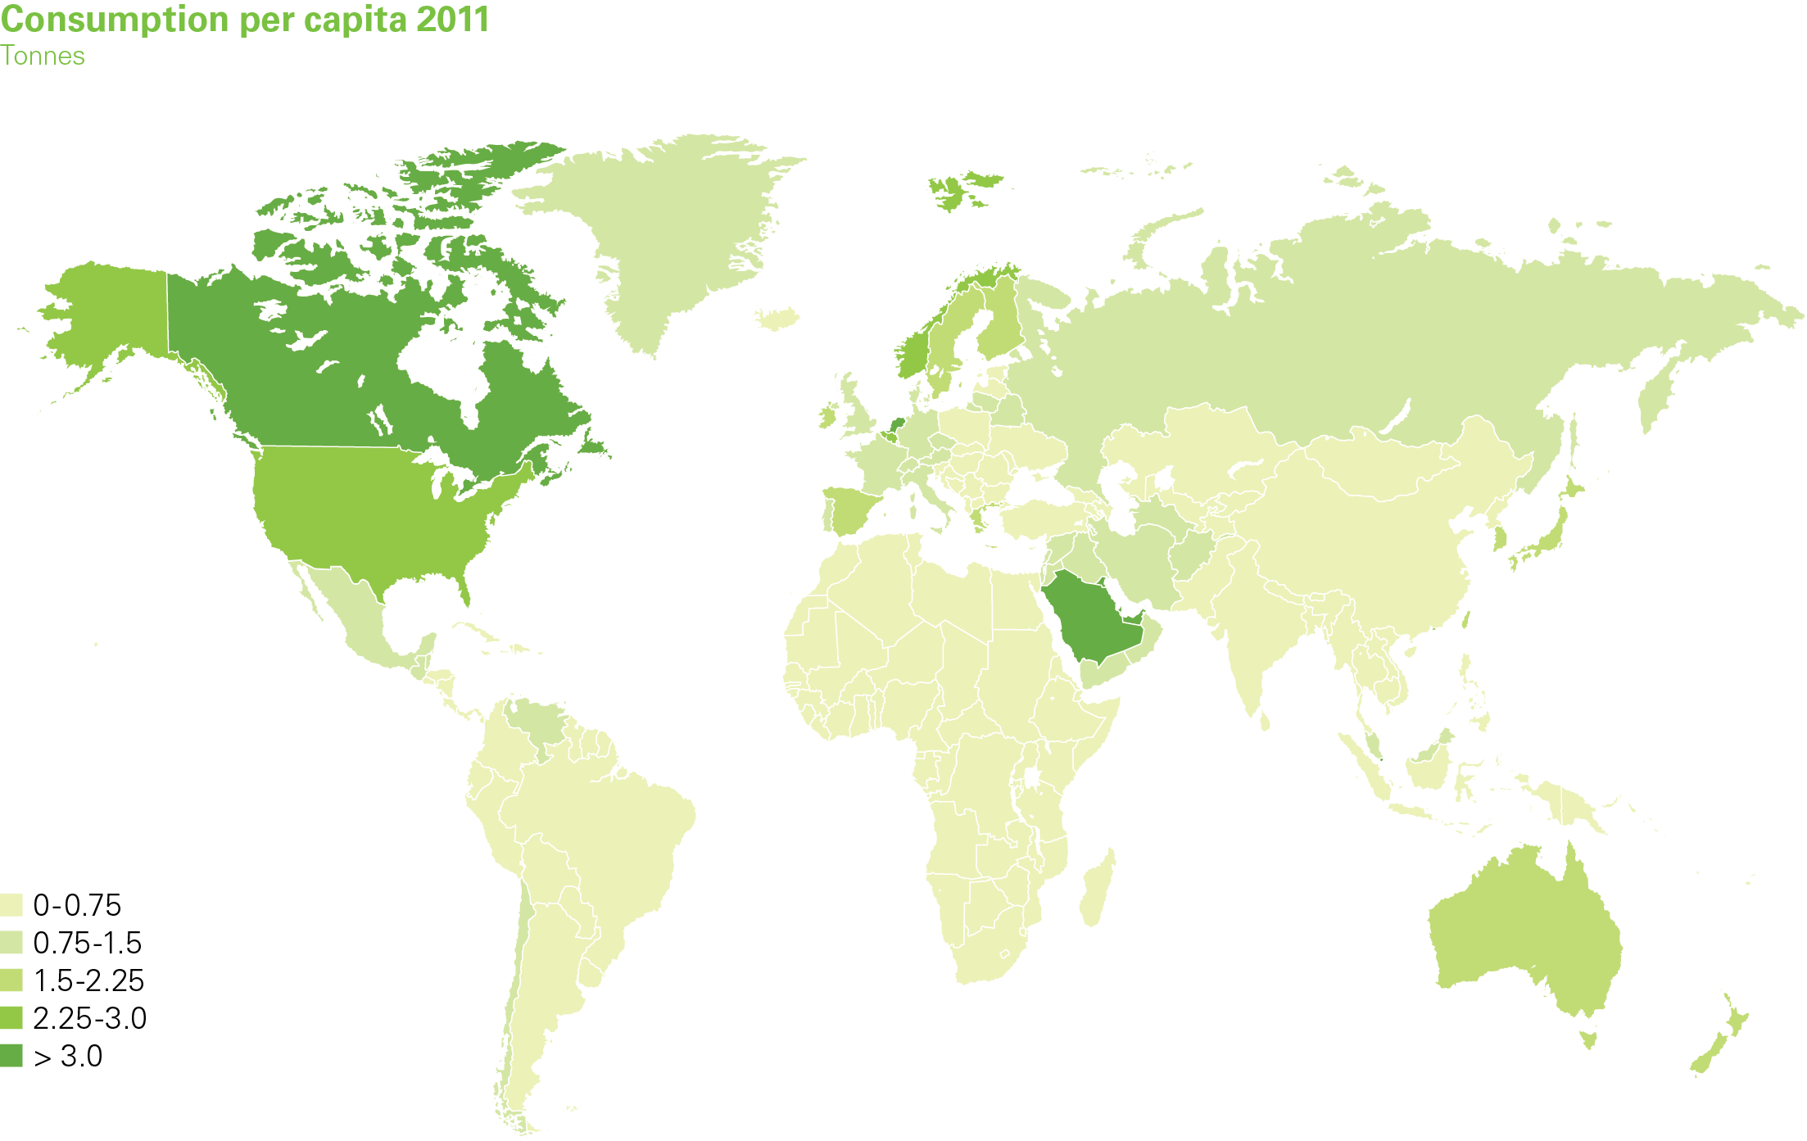
Oil consumption per capita 2011
BP Statistical Review of World Energy 2012
© BP 2012

Slide 16
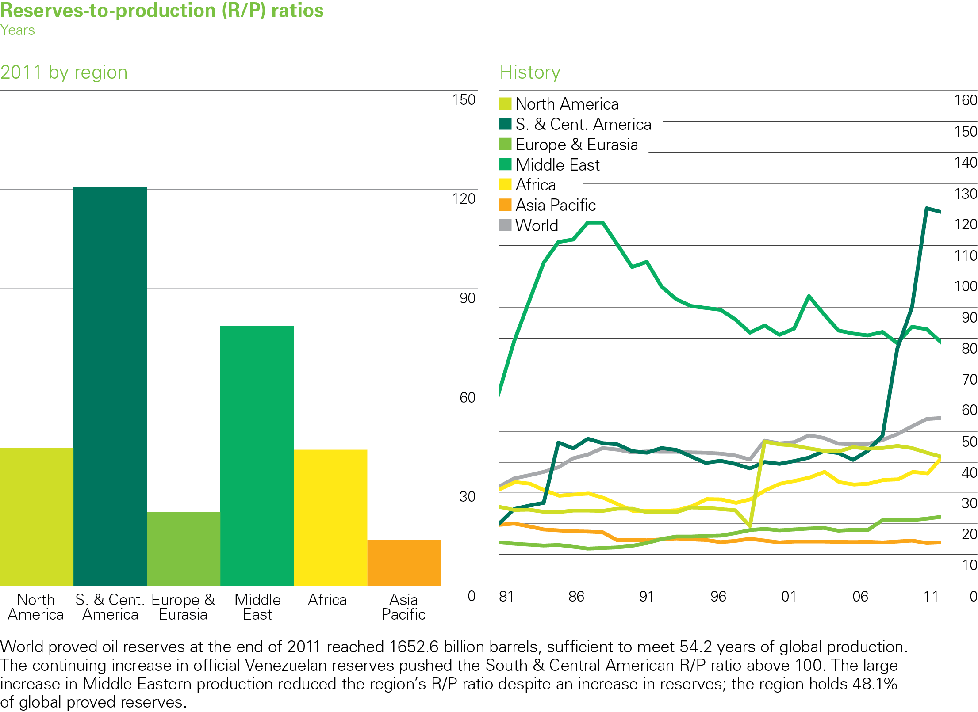
Oil reserves-to-production (R/P) ratios
2011
BP Statistical Review of World Energy 2012
© BP 2012

Slide 17
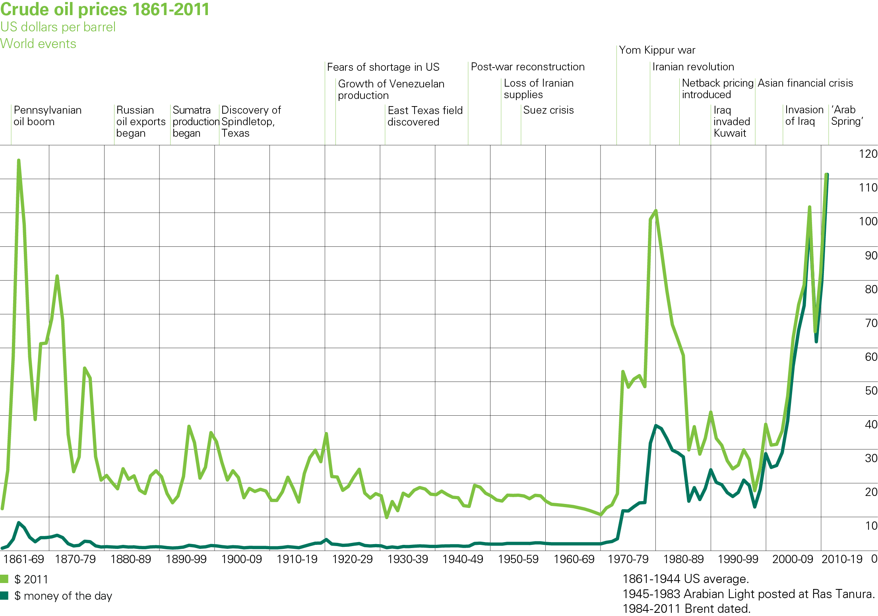
Chart of crude oil prices since 1861
BP Statistical Review of World Energy 2012
© BP 2012

Slide 18

Natural Gas

Slide 19
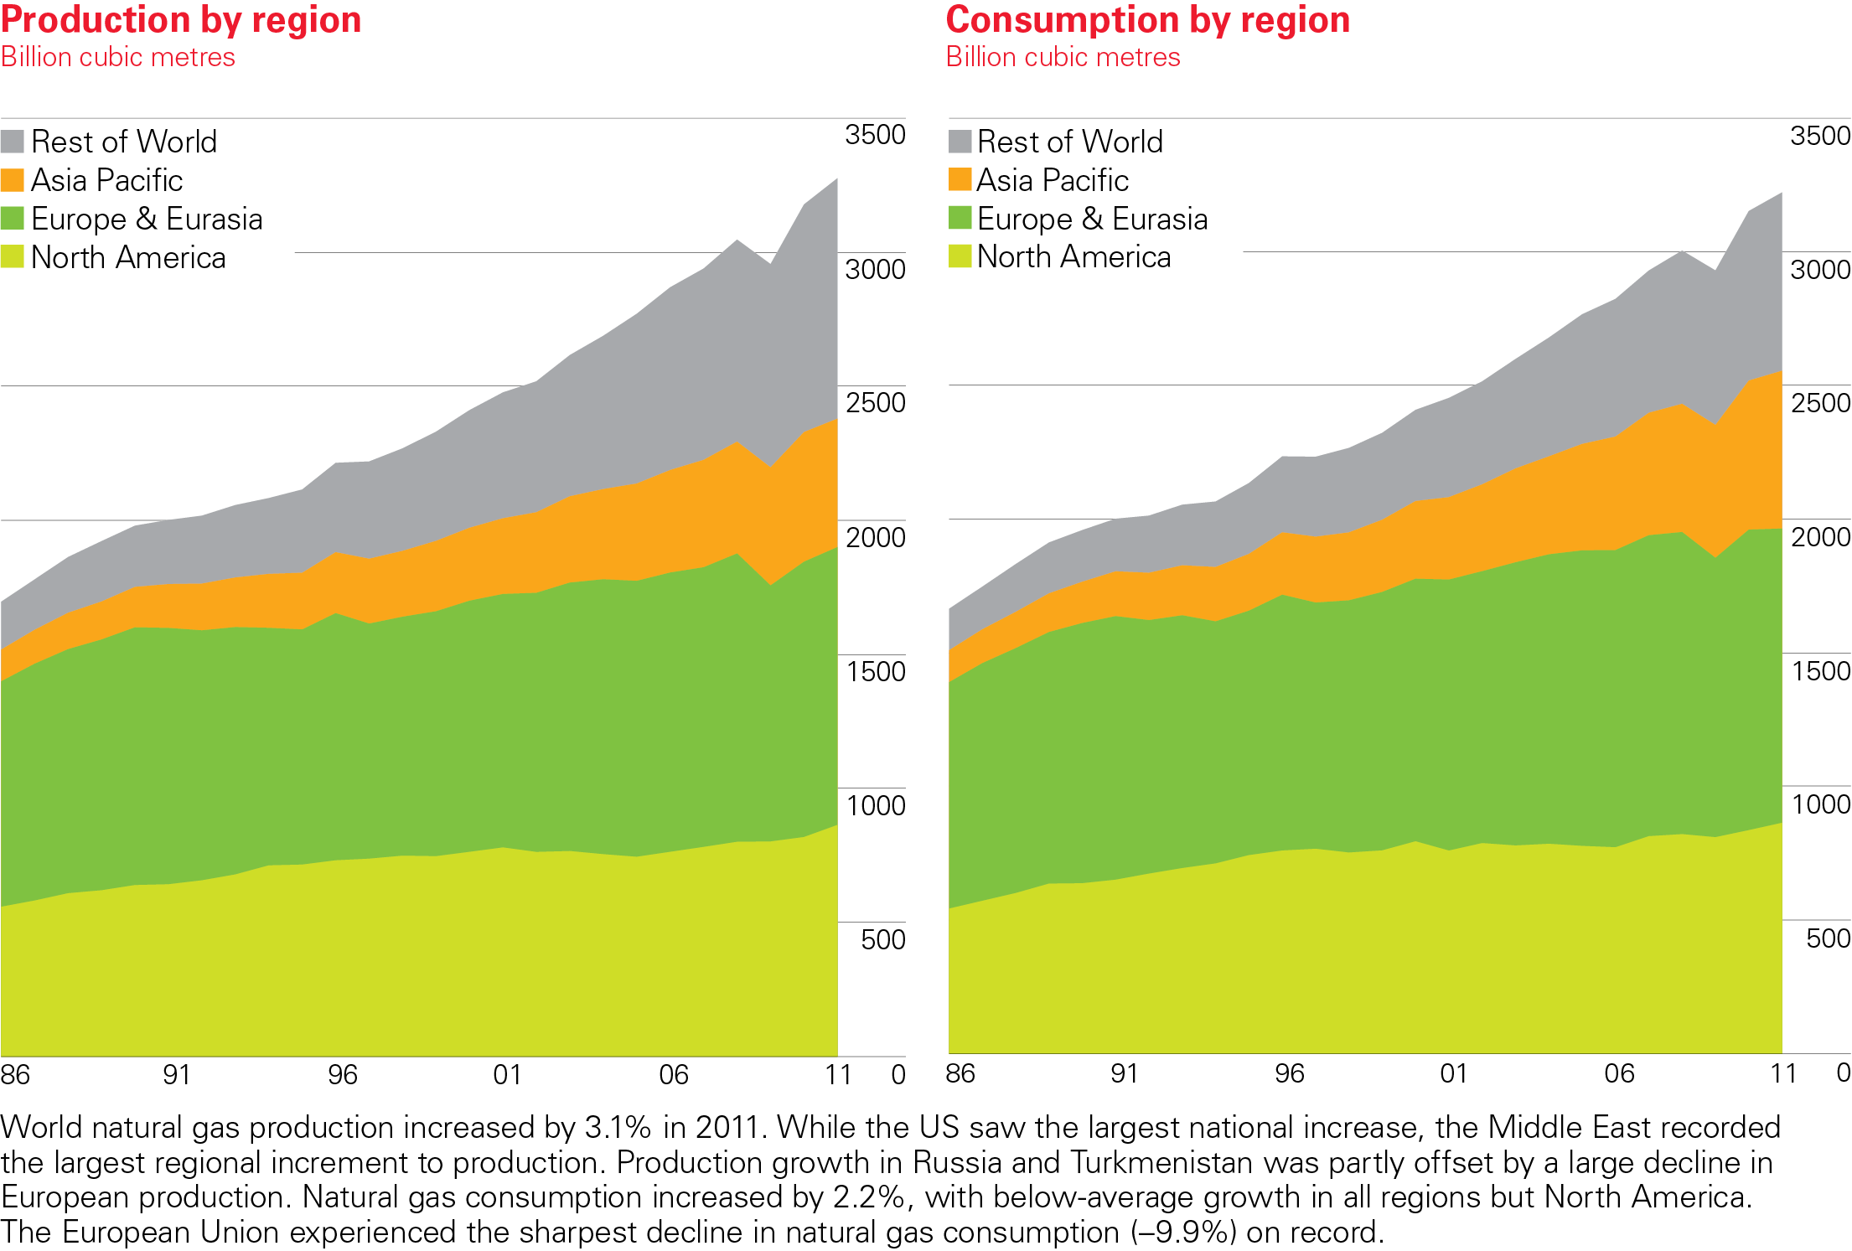
Natural gas production/consumption by region 2011
BP Statistical Review of World Energy 2012
© BP 2012

Slide 20
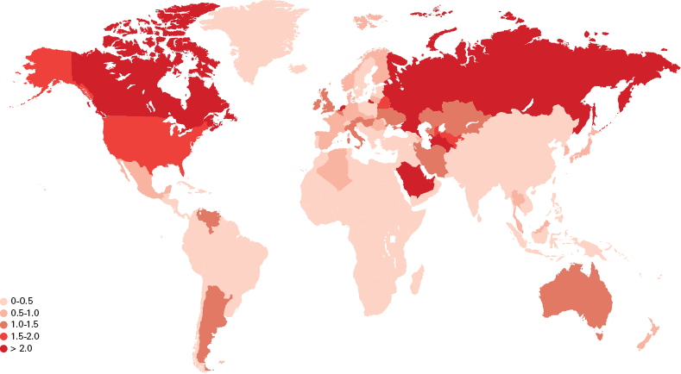
Natural gas consumption per capita 2008
Tonnes oil equivalent
Source: BP Statistical Review of World Energy June 2009

Slide 21
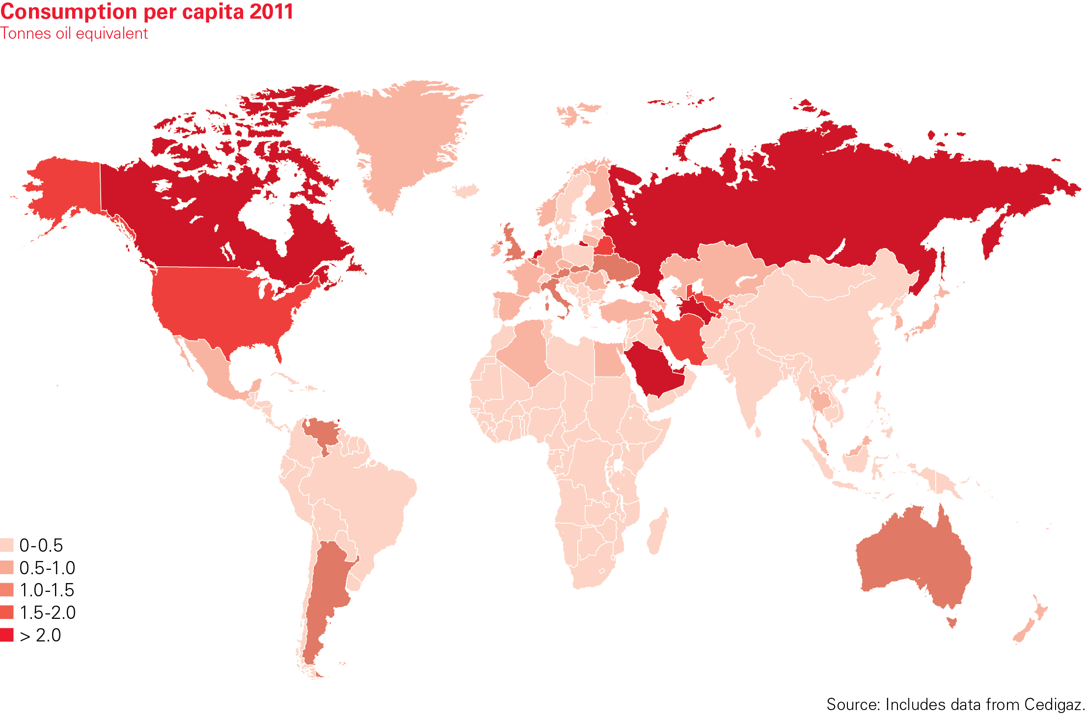
Natural gas consumption per capita 2011
BP Statistical Review of World Energy 2012
© BP 2012

Slide 22
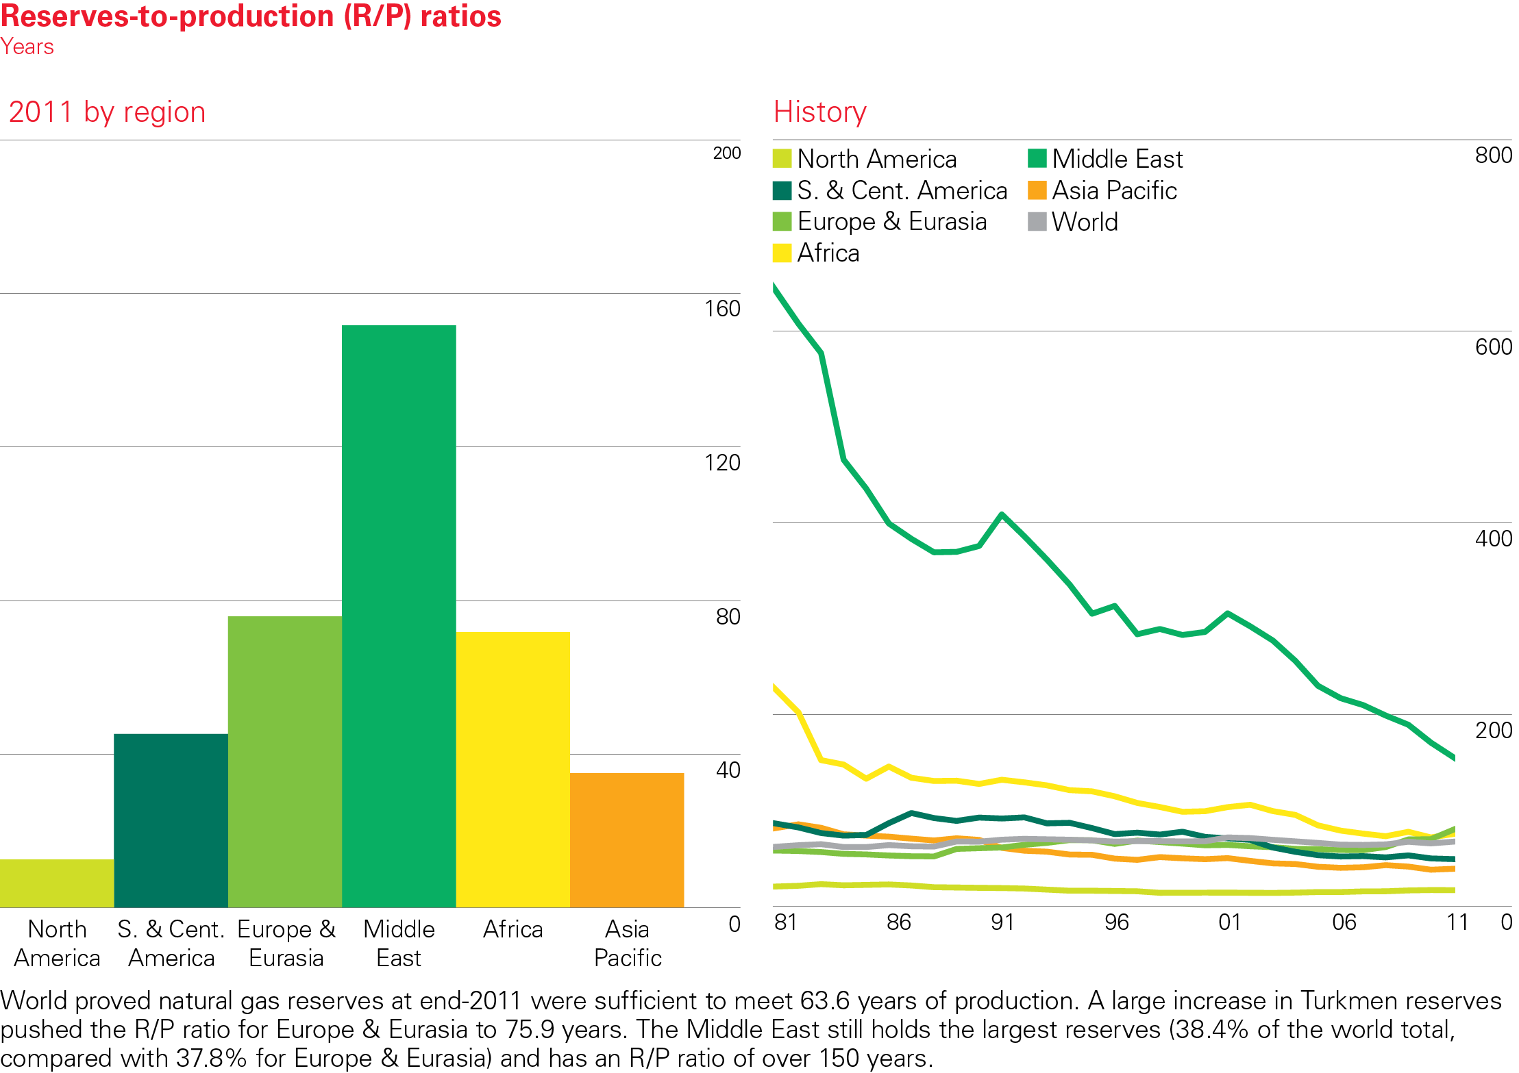

Natural gas reserves to production ratio 2011
BP Statistical Review of World Energy 2012
© BP 2012

Slide 23
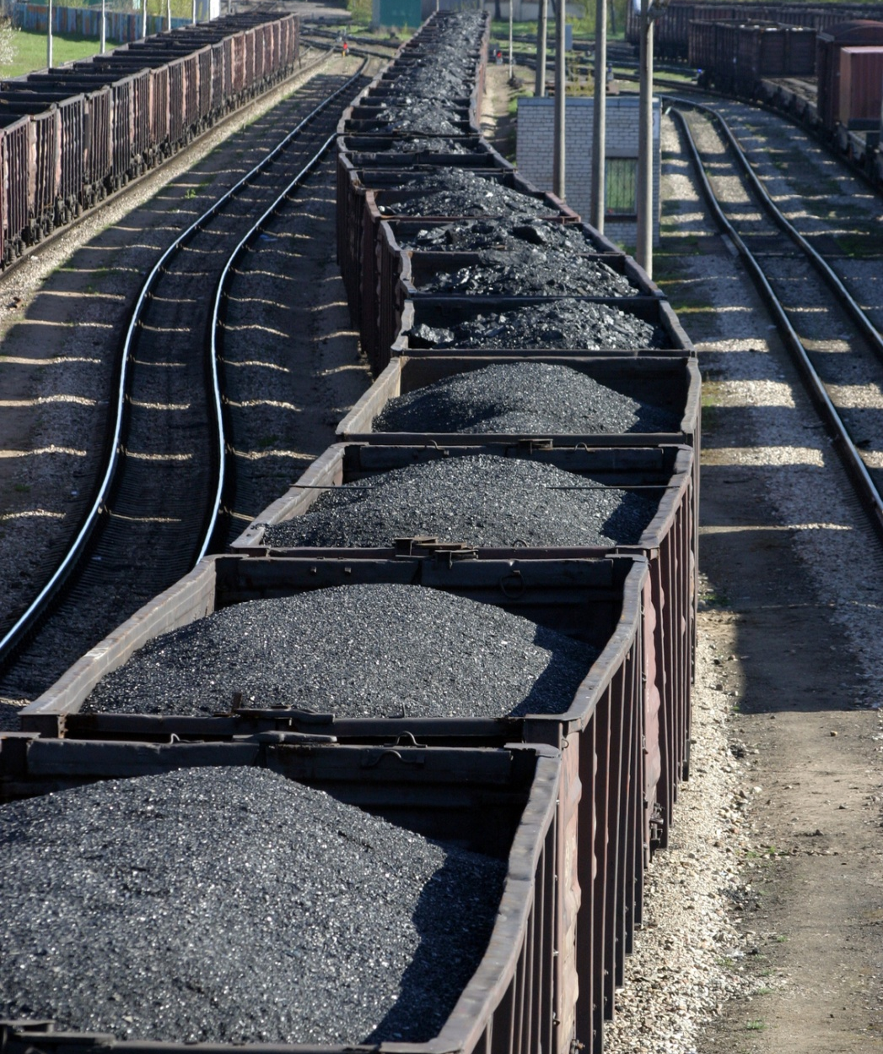
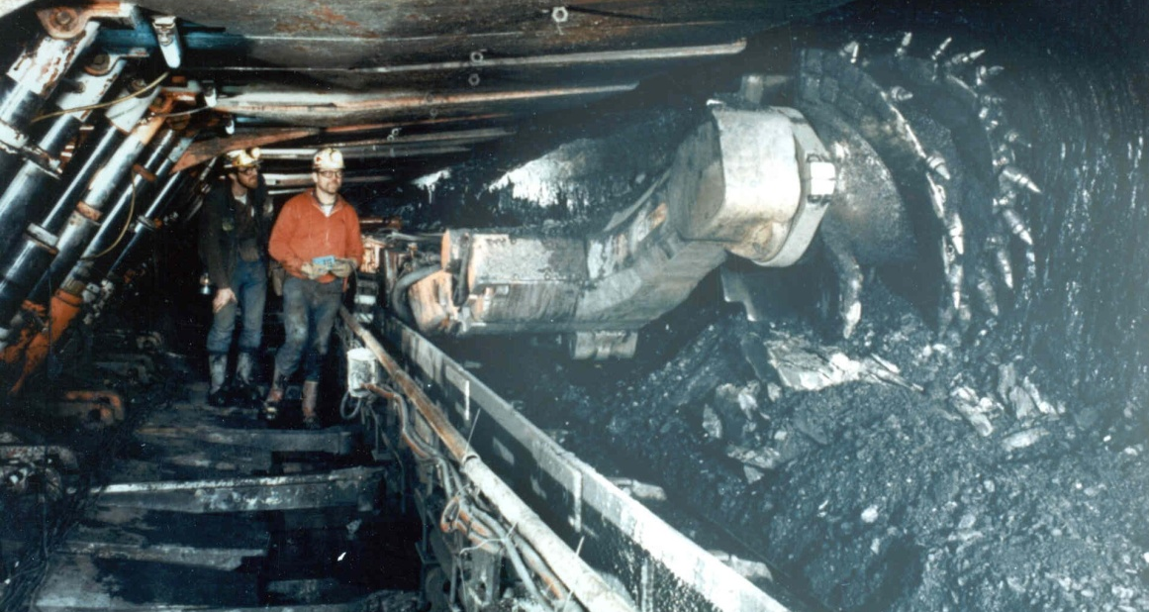
Coal

Slide 24
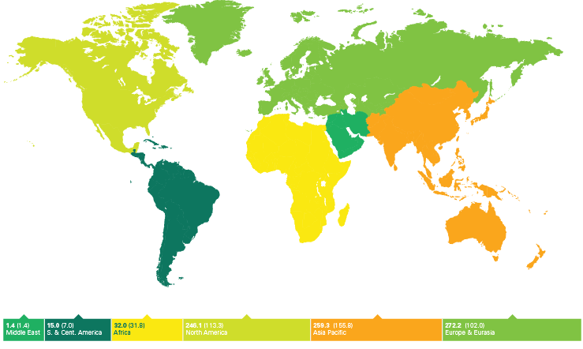
Proved coal reserves 2008
Source: BP Statistical Review of World Energy June 2009
246.1 (113.3)
259.3 (155.8)
272.2 (102.0)
15.0 (7.0)
32.0 (31.8)
1.4 (1.4)
Thousand million tonnes (anthracite & bituminous coal in brackets)

Slide 25
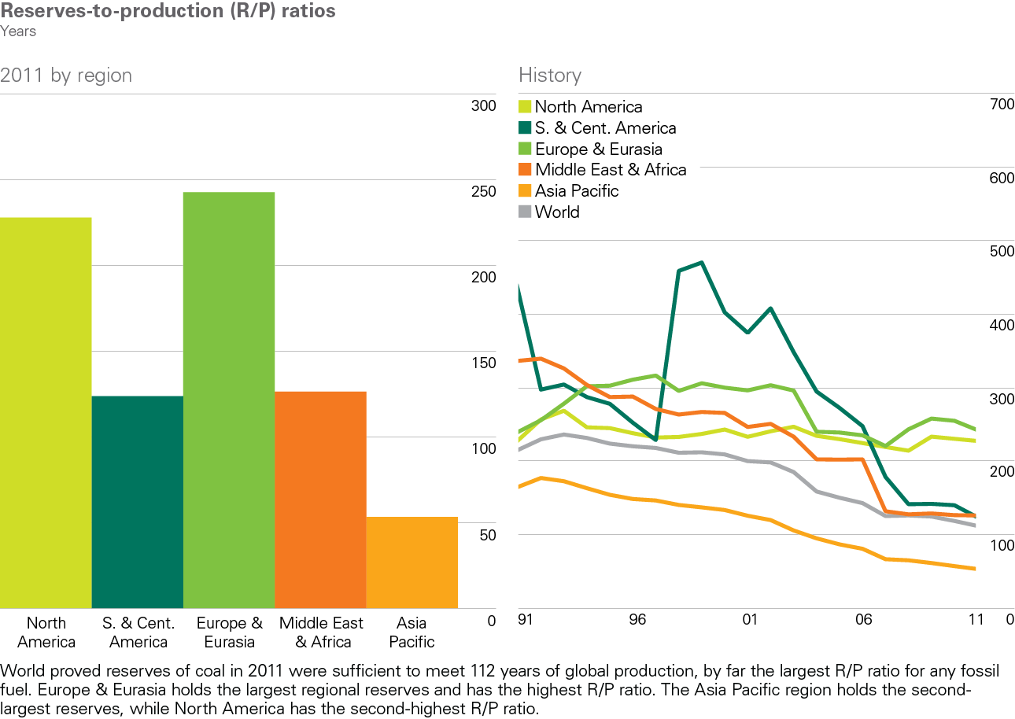
Coal reserves-to-production ratios 2011
BP Statistical Review of World Energy 2012
© BP 2012

Slide 26
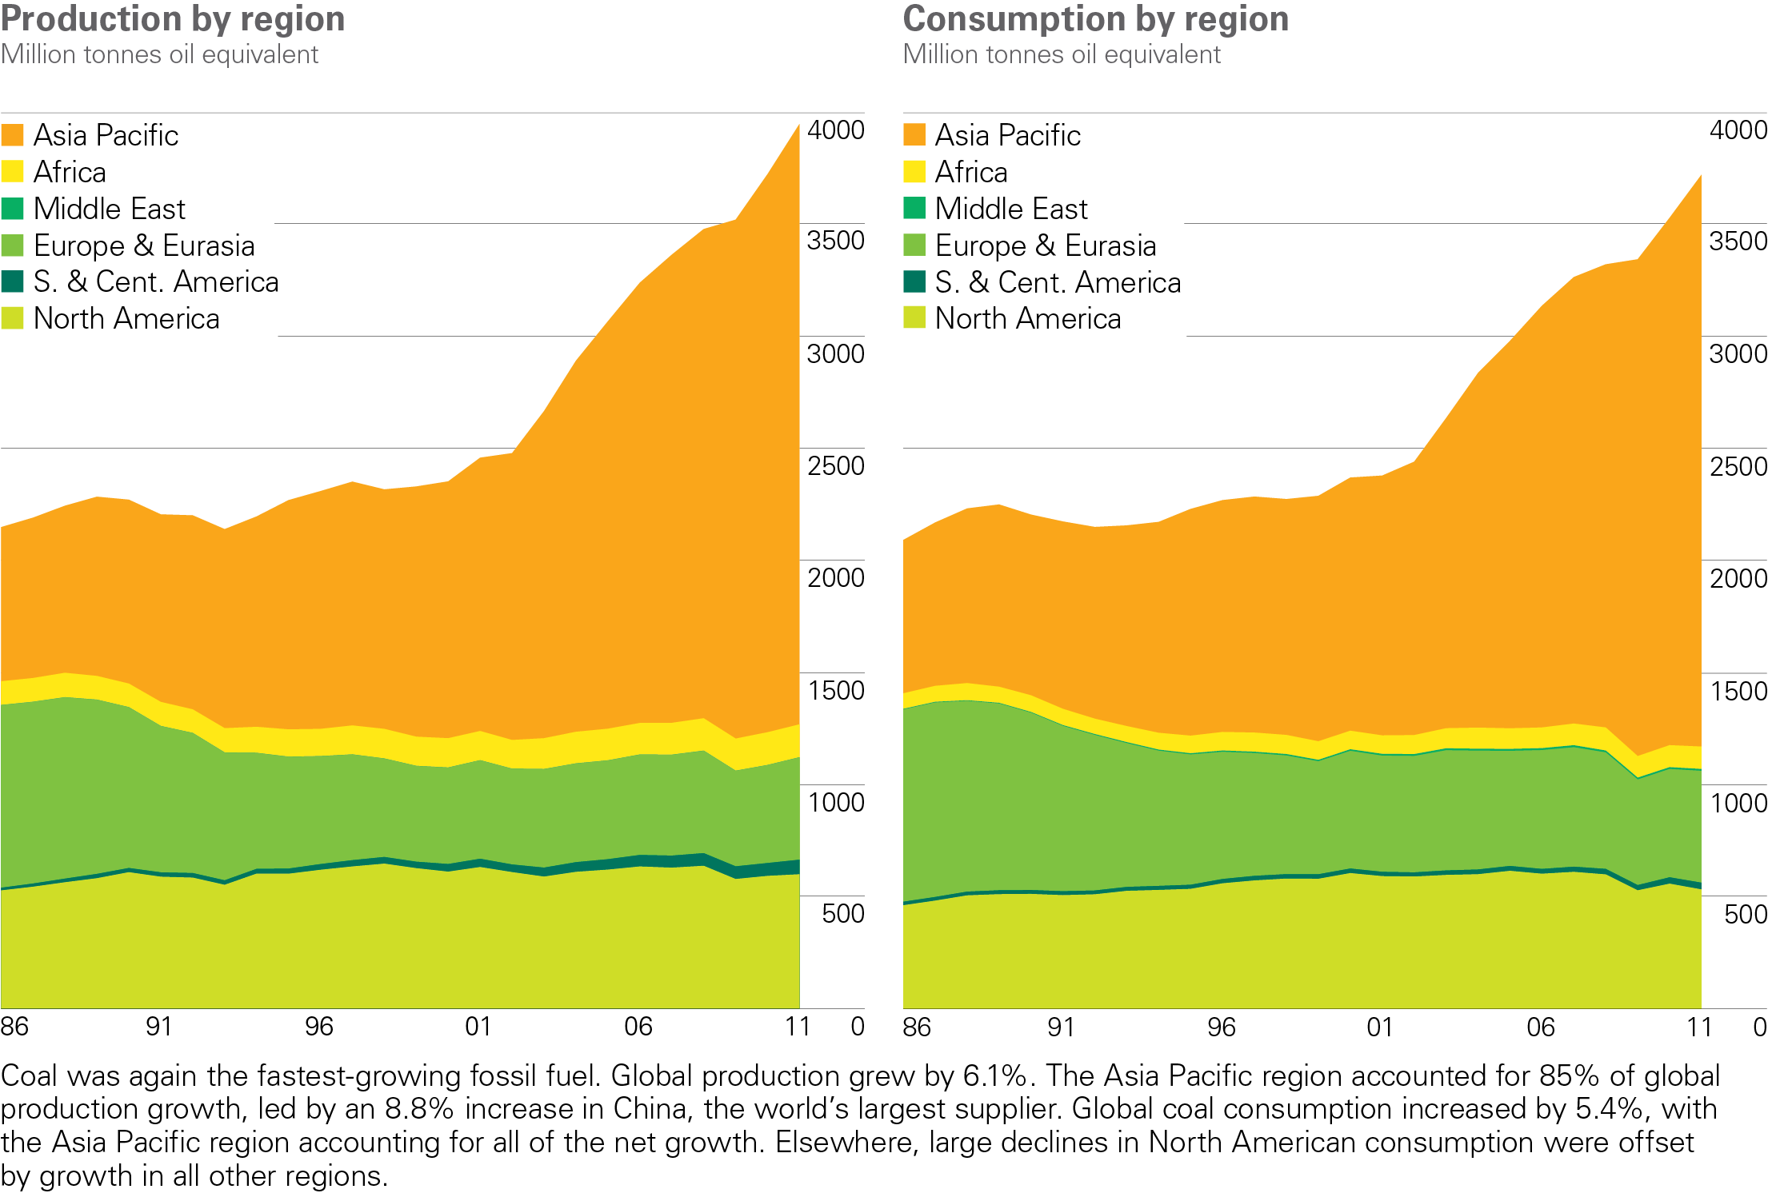
Coal production/consumption by region
BP Statistical Review of World Energy 2012
© BP 2012

Slide 27
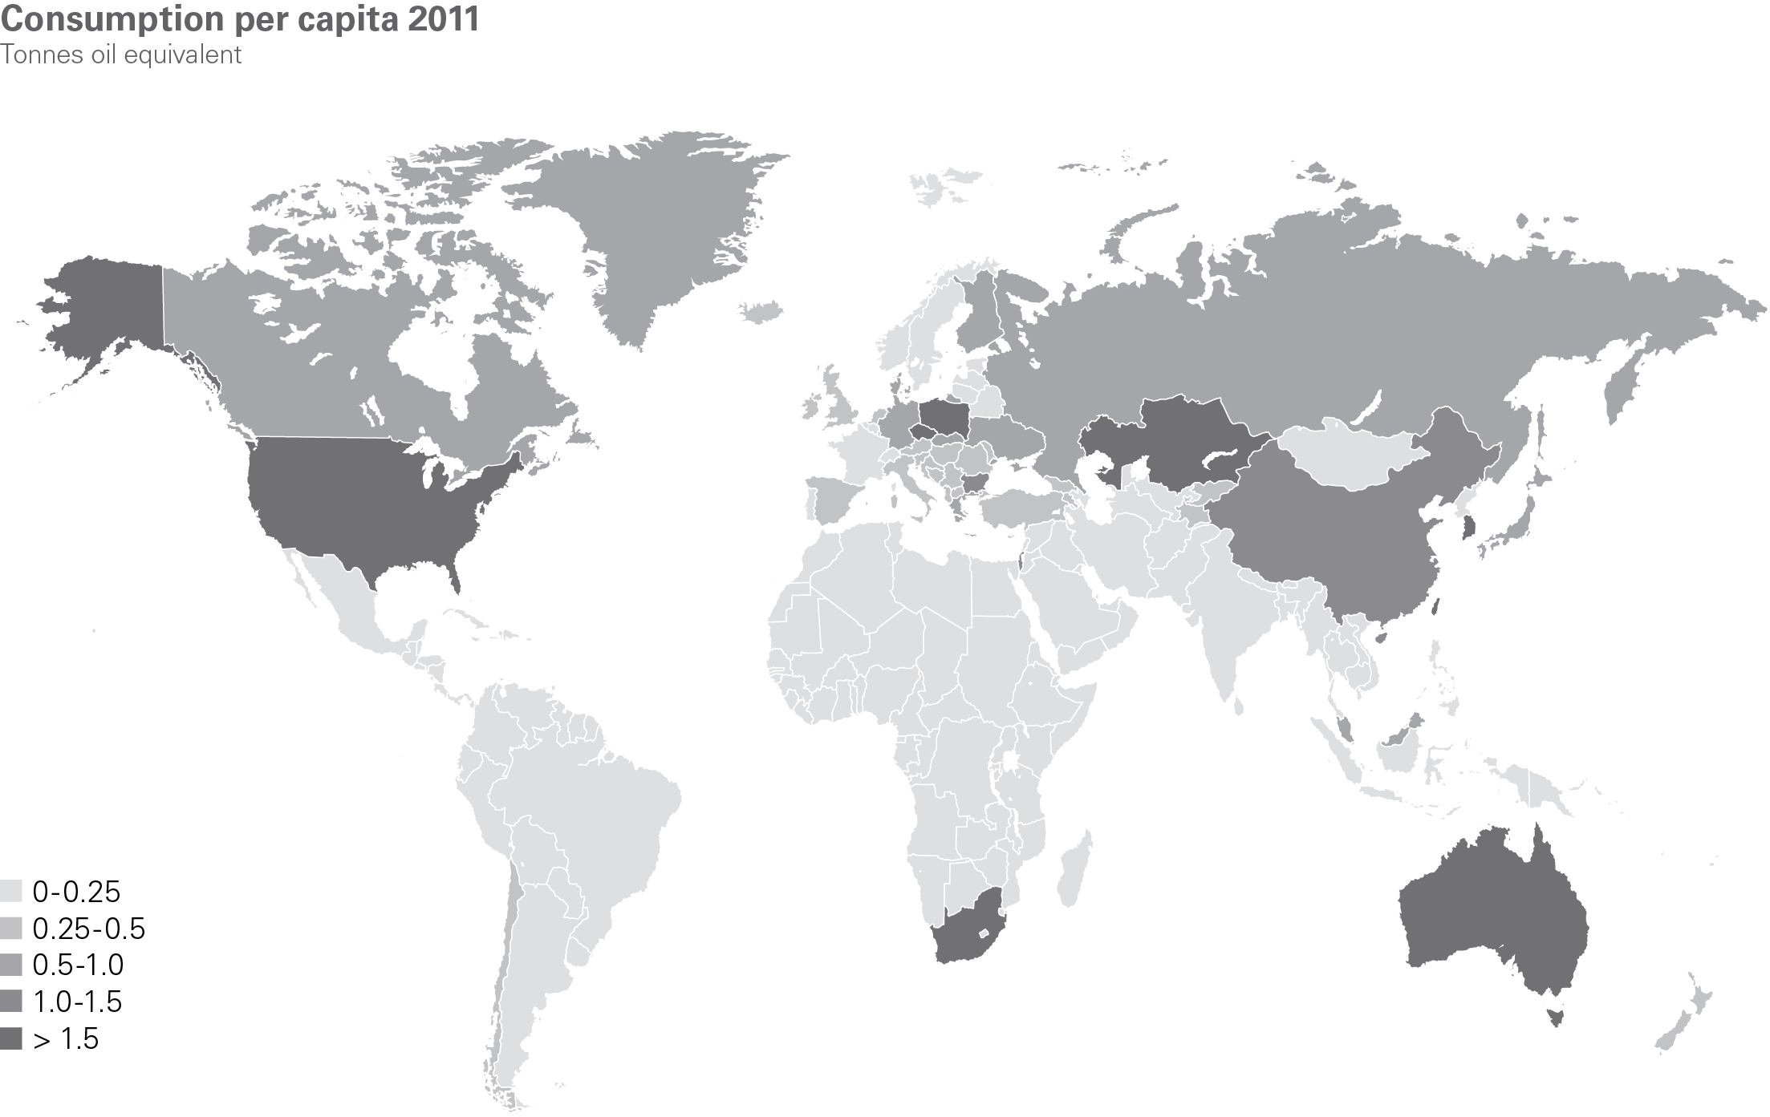
Coal consumption per capita 2011
BP Statistical Review of World Energy 2012
© BP 2012

Slide 28
Nuclear

Slide 29
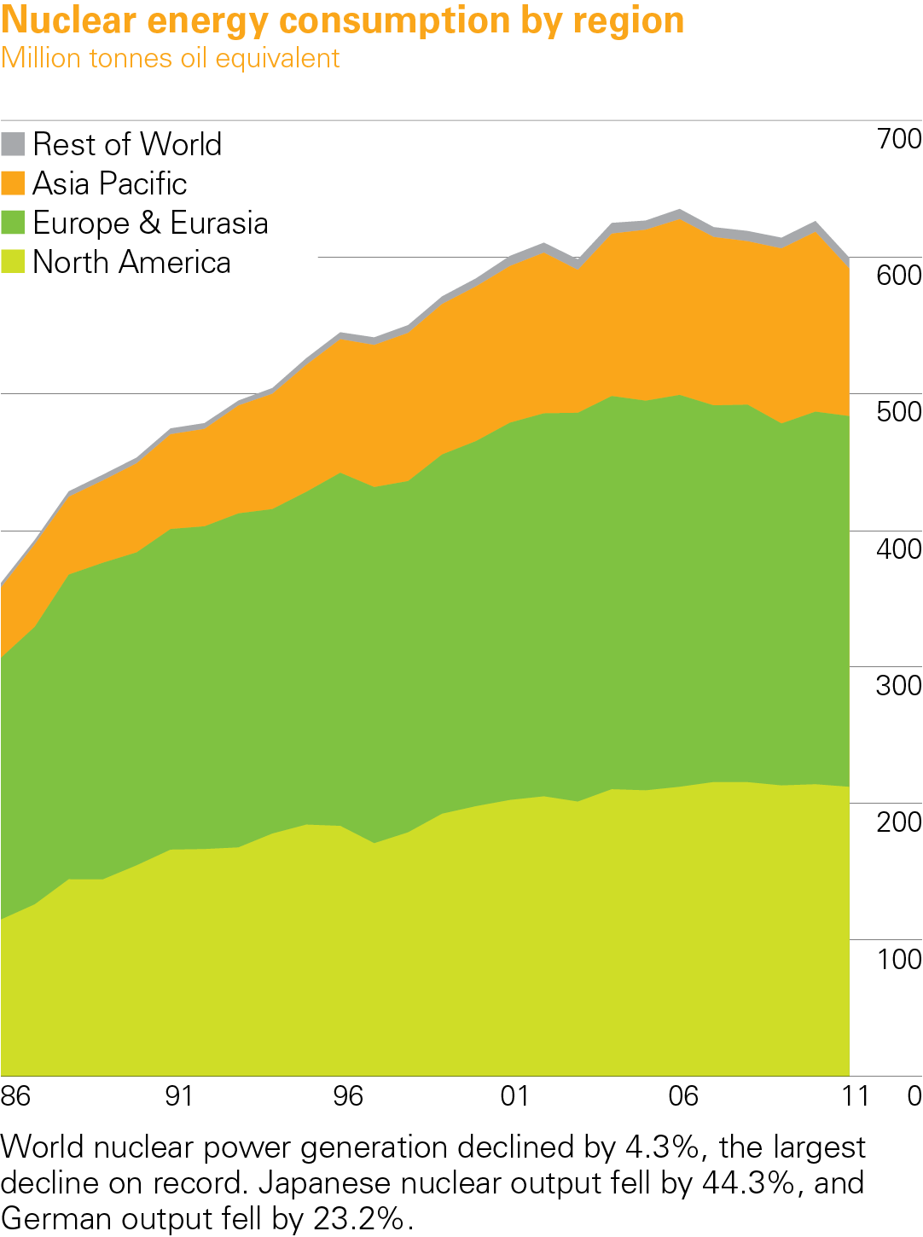
Nuclear energy consumption by region 2011
BP Statistical Review of World Energy 2012
© BP 2012

Slide 30
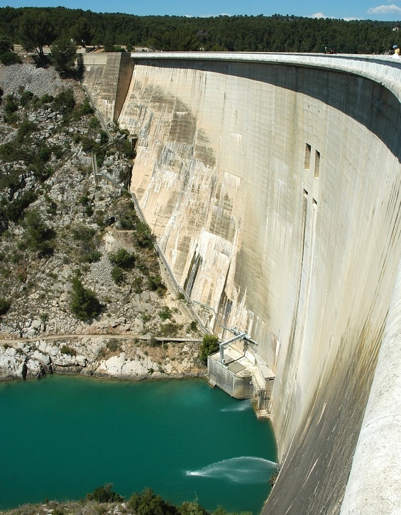
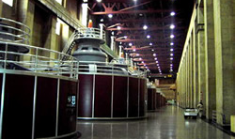
Hydroelectricity

Slide 31
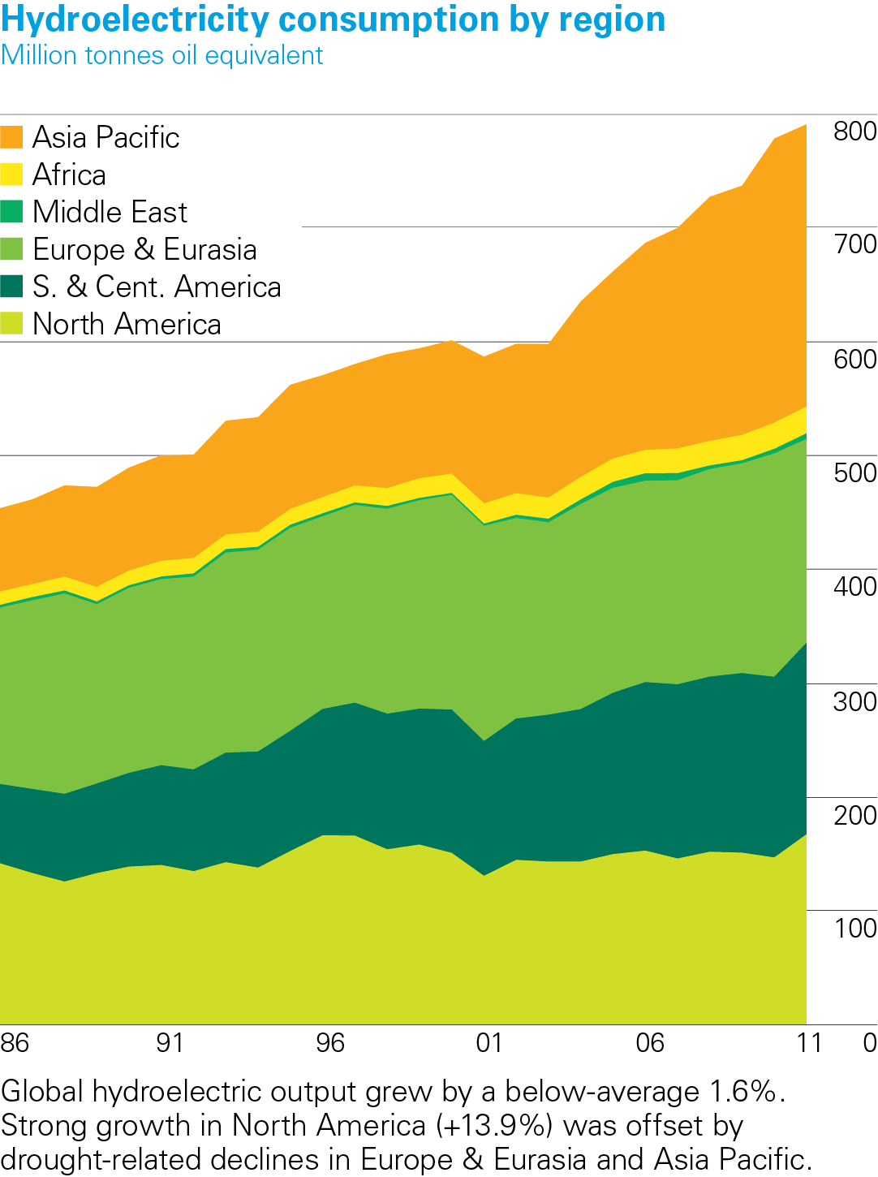
Hydroelectricity consumption by region 2011
BP Statistical Review of World Energy 2012
© BP 2012

Slide 32
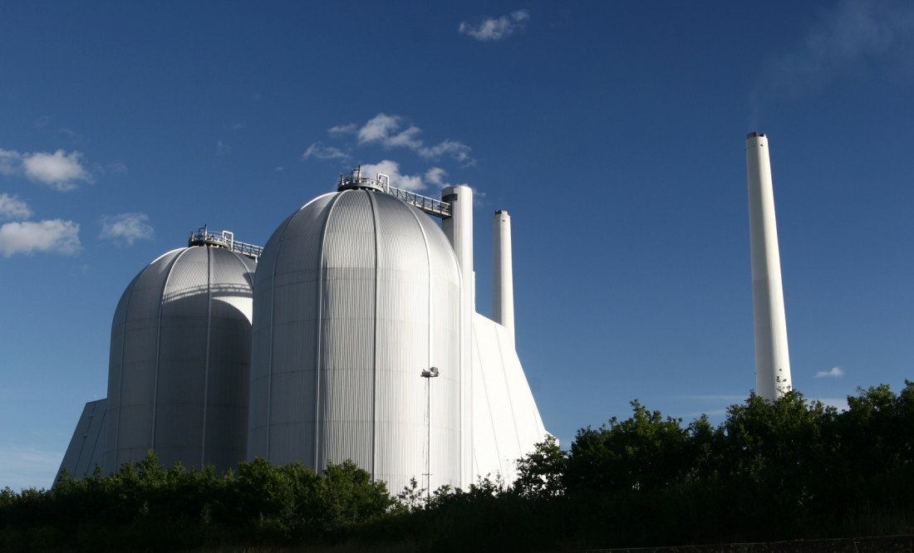

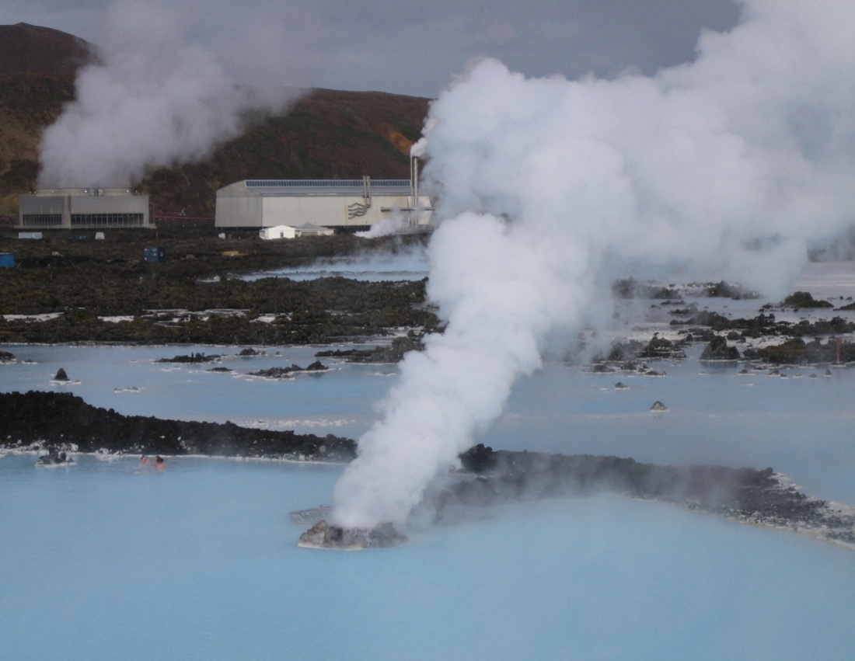

Renewable Energy Technologies

Slide 33

Renewable Energy Technologies
Mainly concerned with producing electricity from sustainable sources:
Biomass
Fuel Cells
Geothermal
Hydro-electricity
Solar photovoltaics (PV)
Tidal
Wave
Wind power
Onshore
Offshore

Slide 34
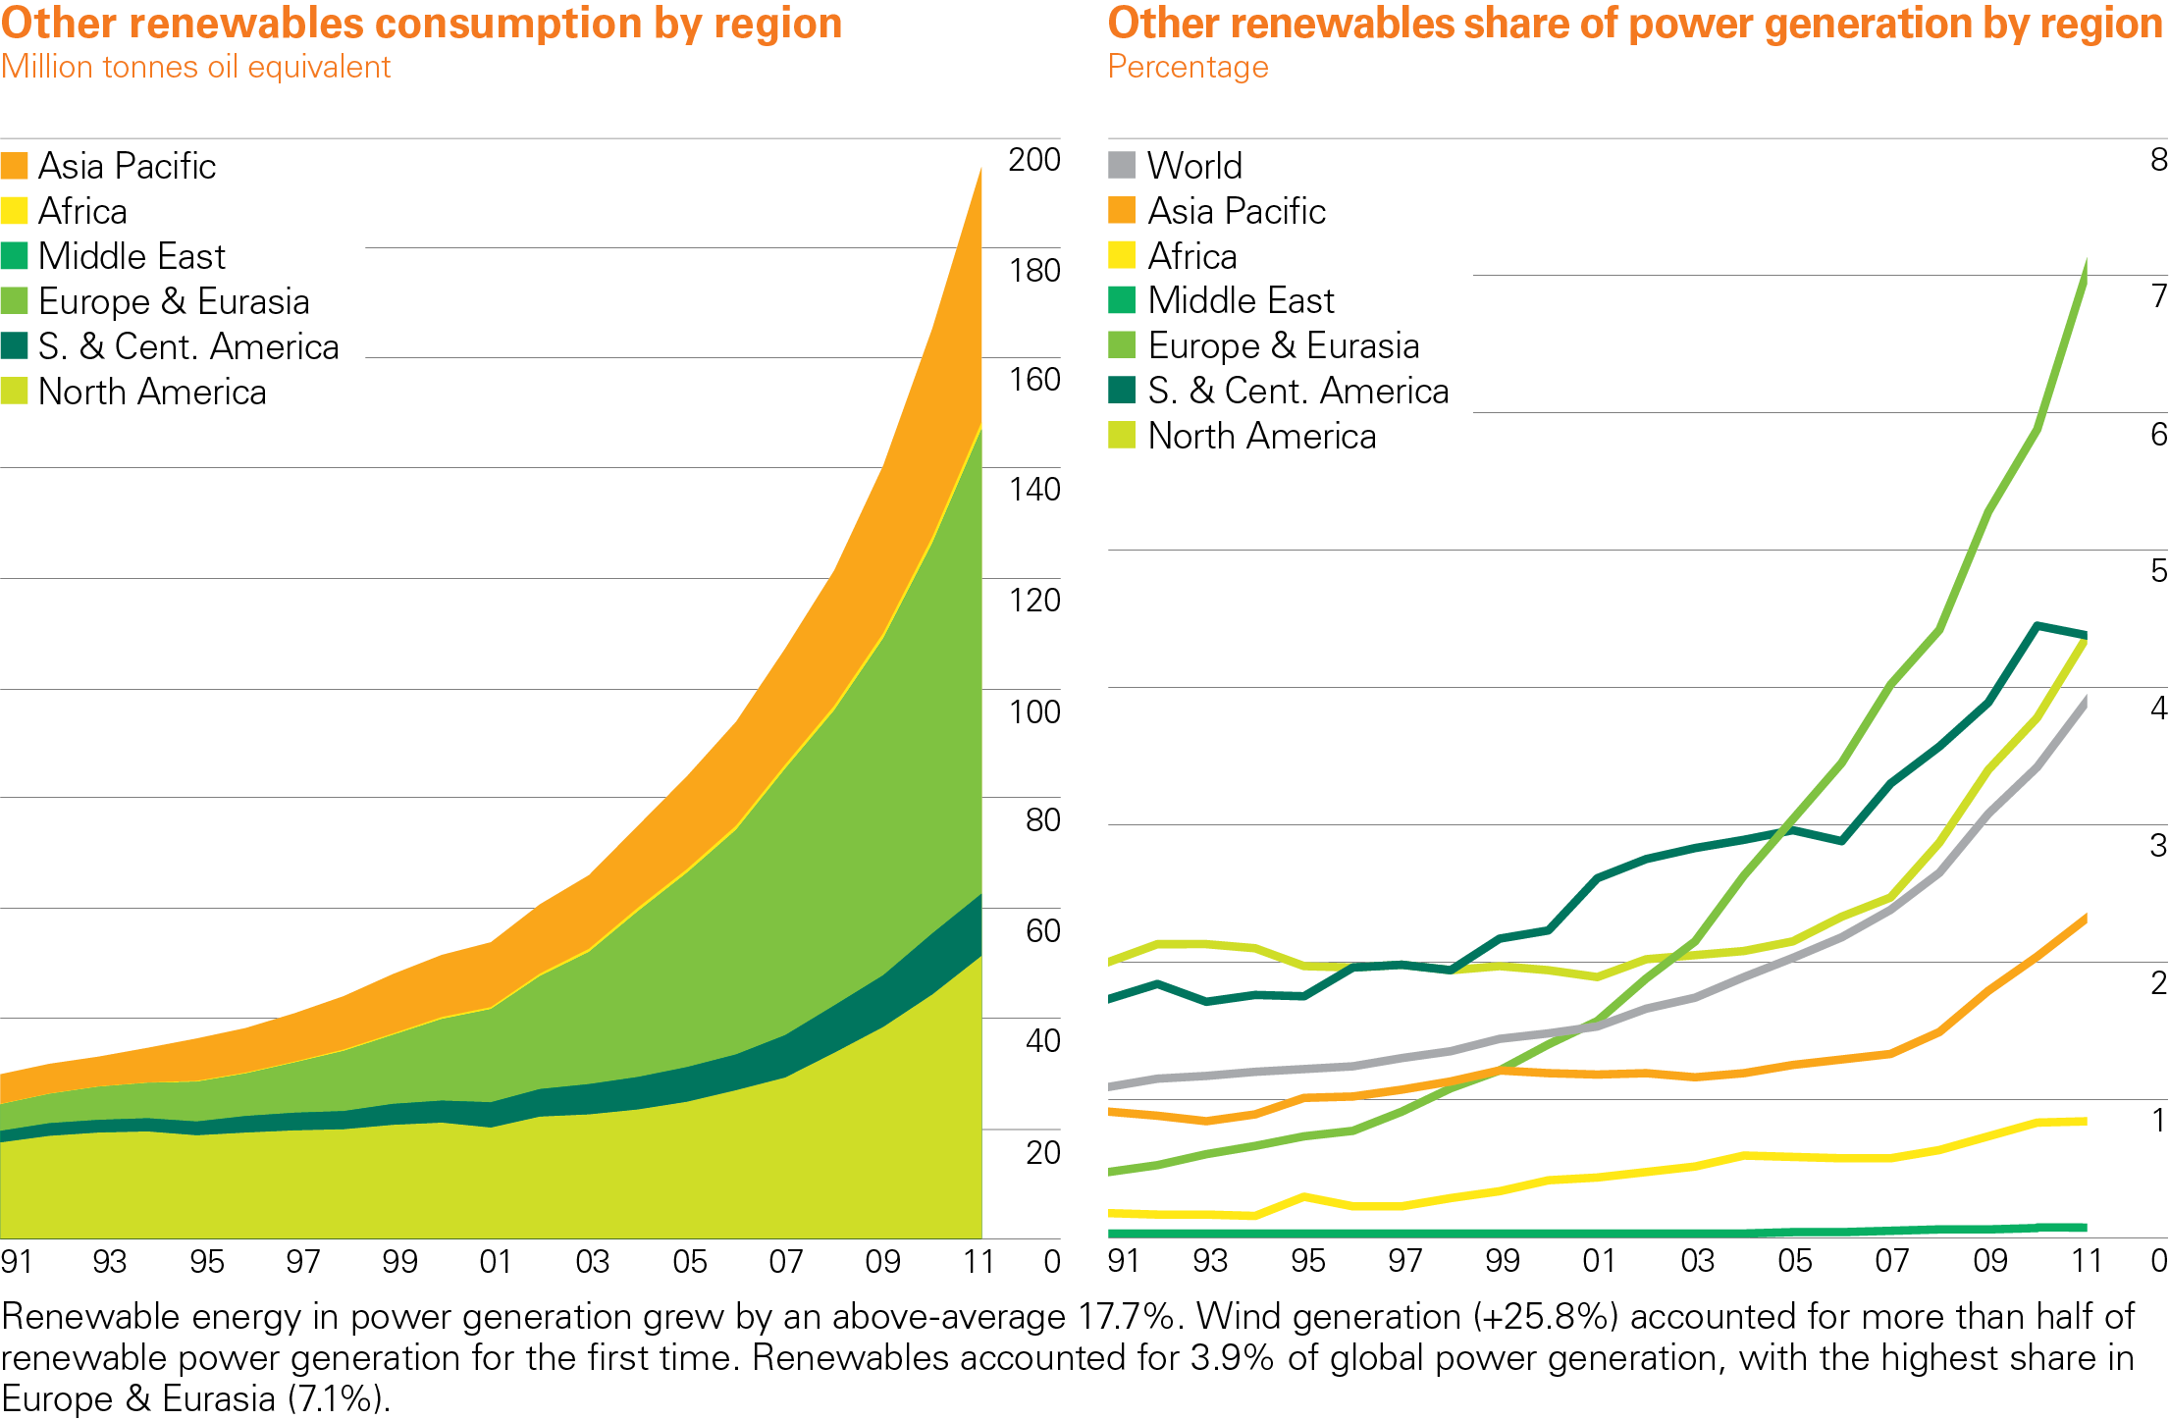
Renewable energy consumption/share of power by region
BP Statistical Review of World Energy 2012
© BP 2012

Slide 35
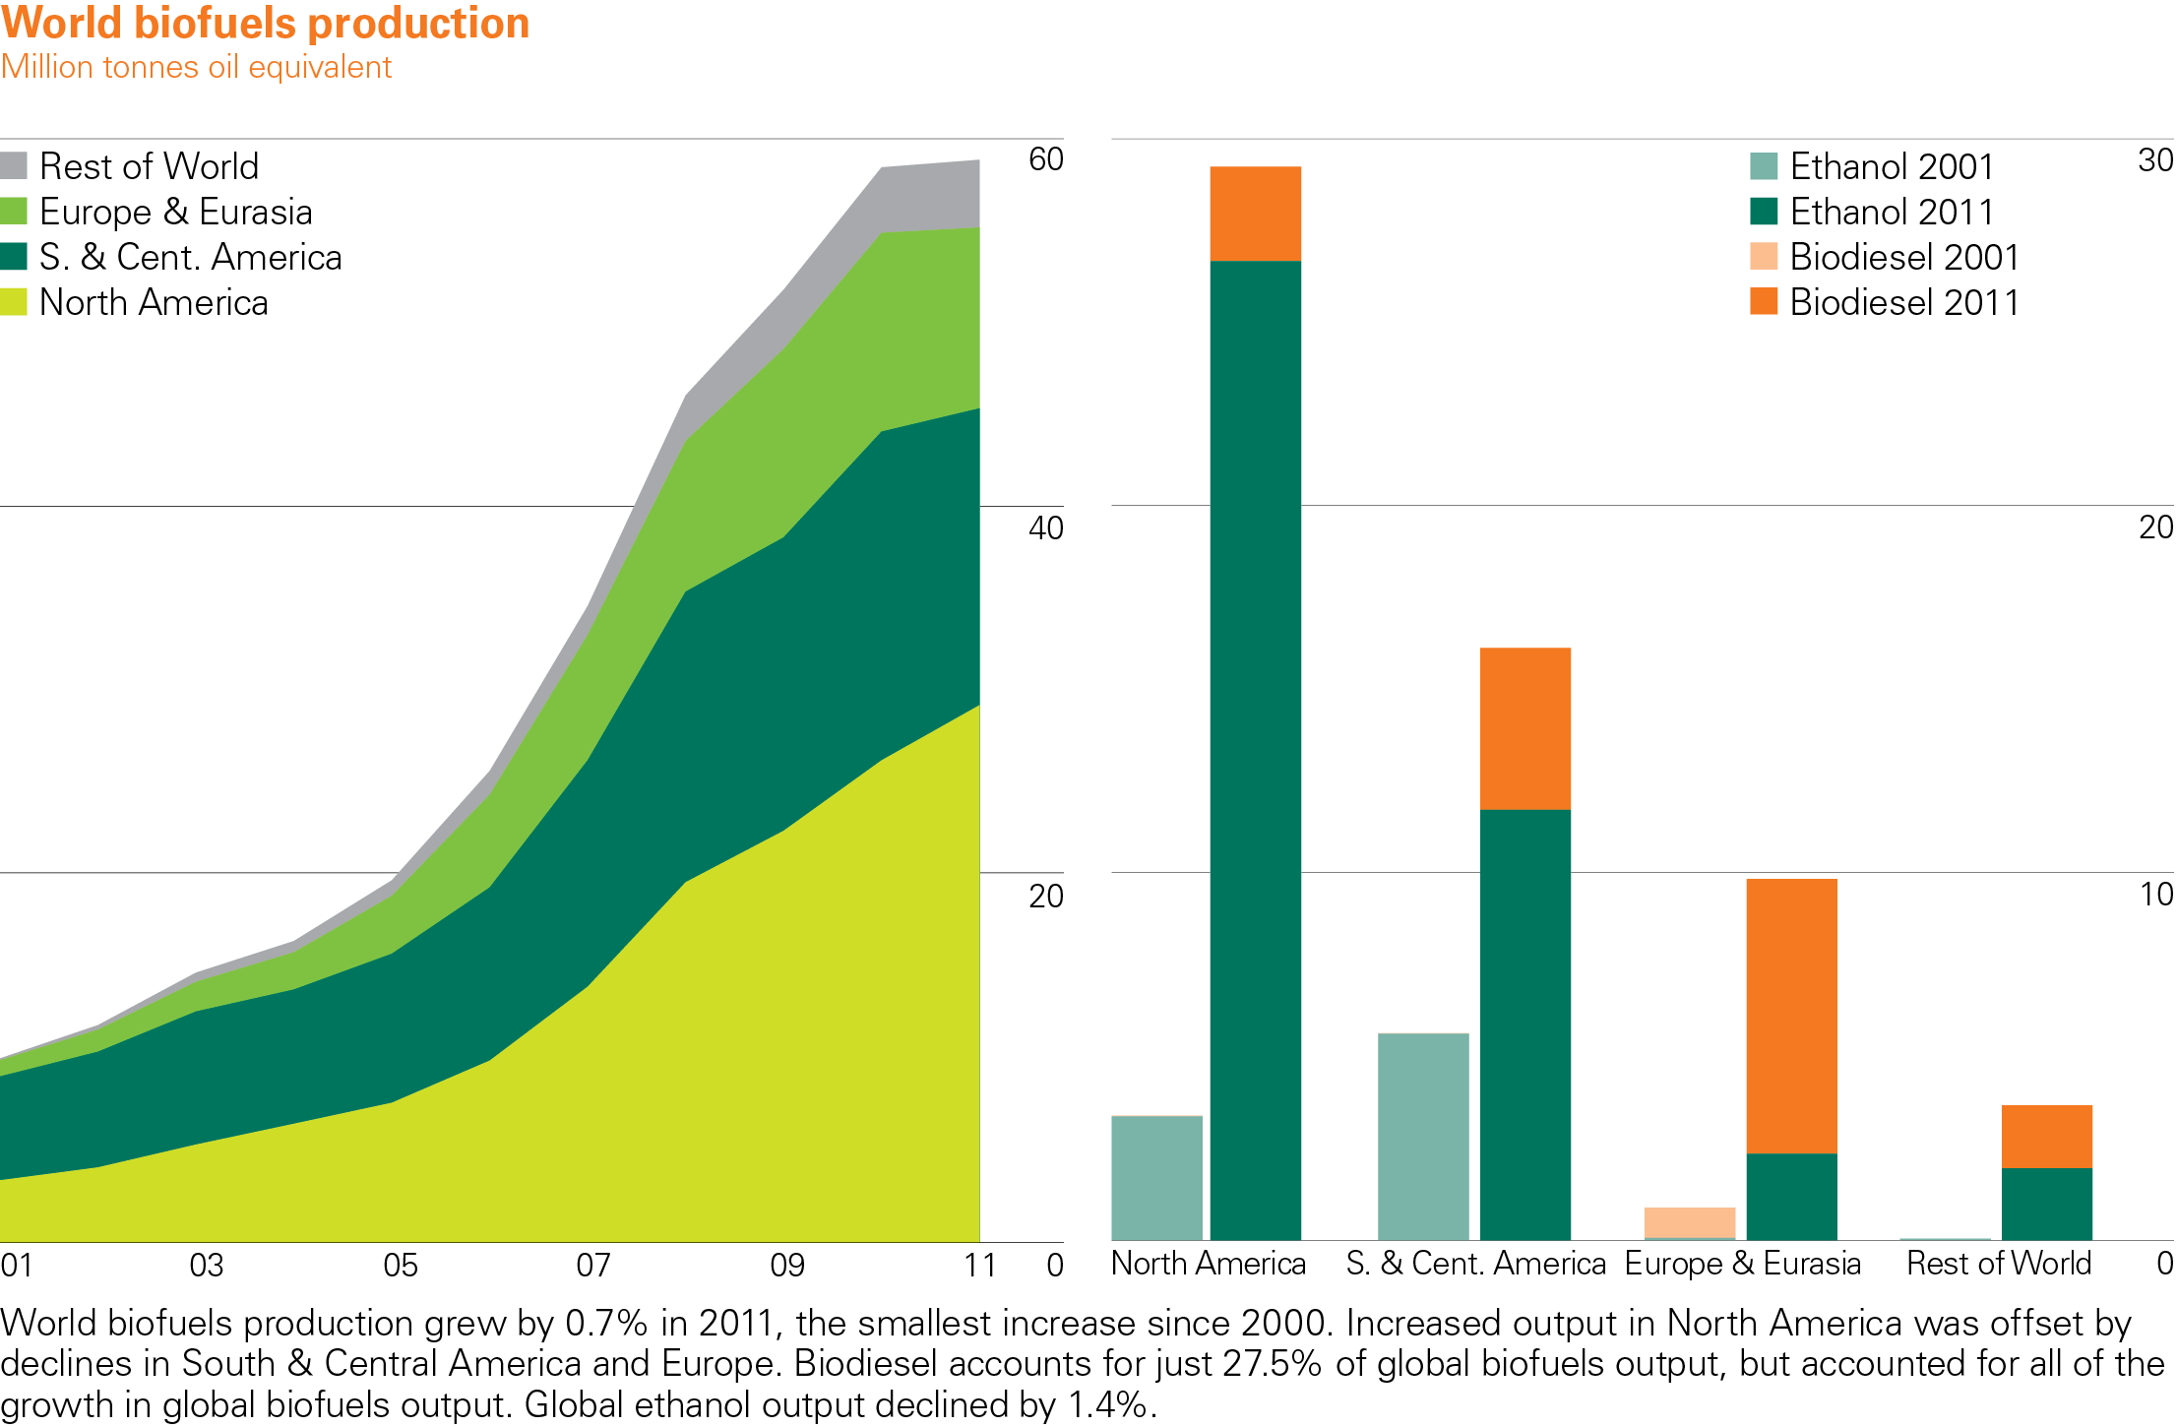
Renewable energy production by region - biofuels
BP Statistical Review of World Energy 2012
© BP 2012

Slide 36
Energy in UK
Oil
Gasoline or Diesel
Transport
4%
(with others)
Gas
Heat
(Homes & Business)
37%
Coal
34%
Renewables
5%
Electricity
Nuclear
Power Services
(Homes & Business)
20%
Zero/Low CO₂
High CO₂

